Slide 1
Introduction of mathematical models
06/08/2021

Slide 2
All models are wrong, but some are useful

Slide 3
History of bioinformatics -> computational biology (human)
Before the human genome project
Mathematical models + systems biology
(Hypothesis + theoretical models)
The human genome project
Annotation of human genome
(Understanding the role of different genes, protein structures,…)
Post the human genome project
Statistical analysis of context (organ, tissue, disease, cell) specific data
(Understanding to context specific biological characteristics)
New technologies
Microarray
Next generation sequencing
Single cell experiments
…

Slide 4
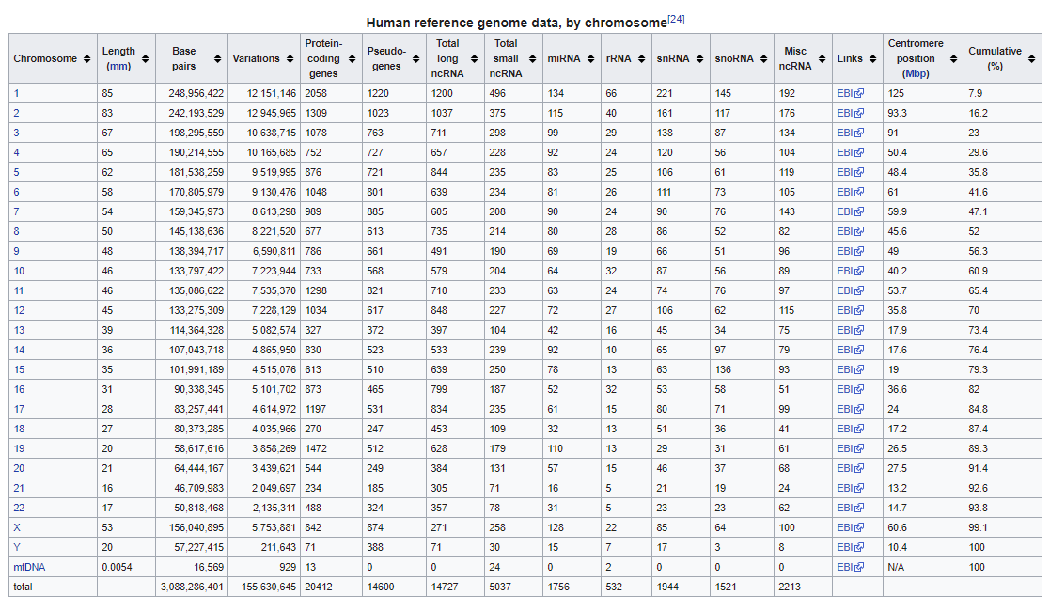

Slide 5
Our further introduction will be in the following aspects
1) Mathematical modeling
2) Biological data (or other data)
3) Biological questions (or other questions)
4) Statistical models
5) programming

Slide 6
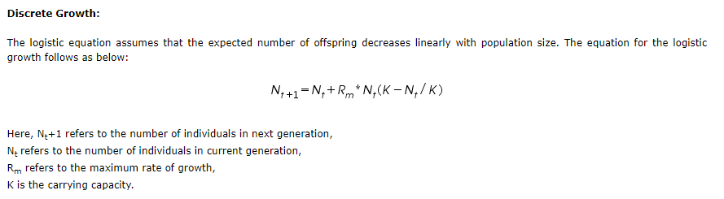
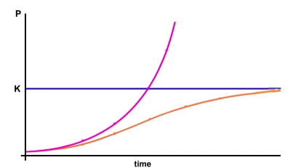


Discrete logistic growth model
$$N_{t}=N_{t−1}+R_{m}∗N_{t −1}(1−\frac{N_{t−1}}{K})$$
$$if N_{t−1}=K →growth rate is 0,$$
$if N_{t−1}<K$ $→growth rate is> 0$
$if N_{t−1}>K$ $→growth rate is< 0$
K=1000

Slide 7
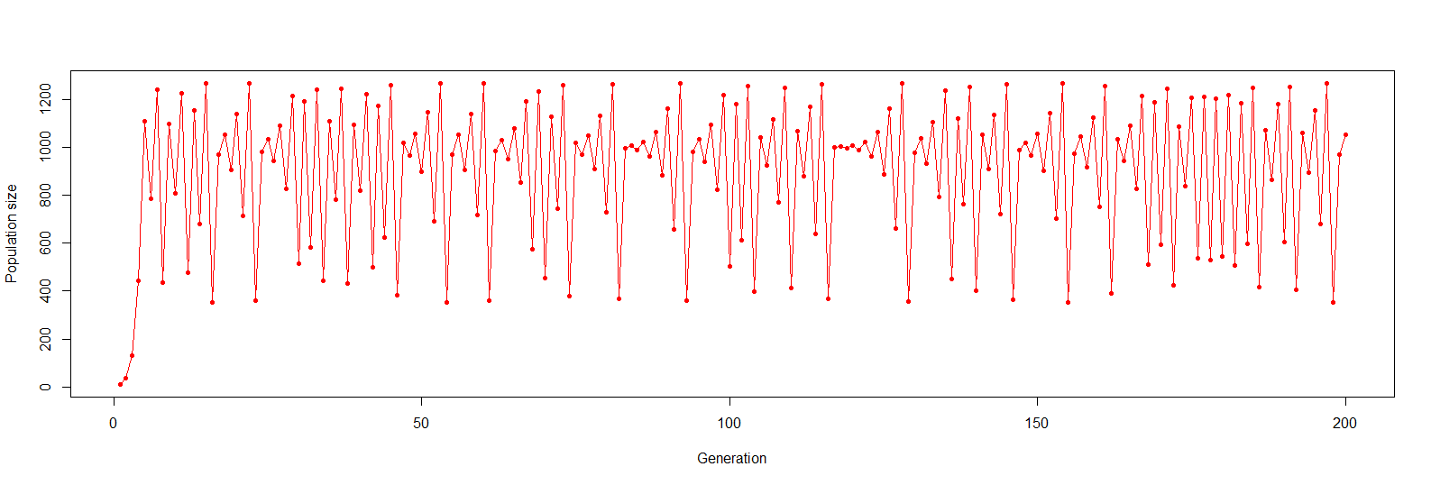
R examples of Discrete logistic growth

Slide 8
2021/06/09

Slide 9
Outline
Microarray data
Data search and download
Load data into R
Statistical distribution
Statistical test
Some Bioinformatics topic

Slide 10


Slide 11
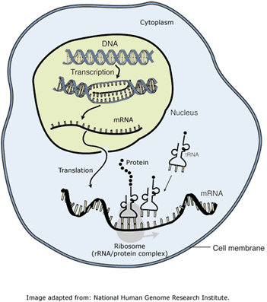
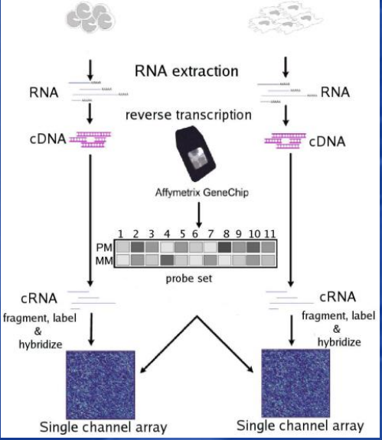
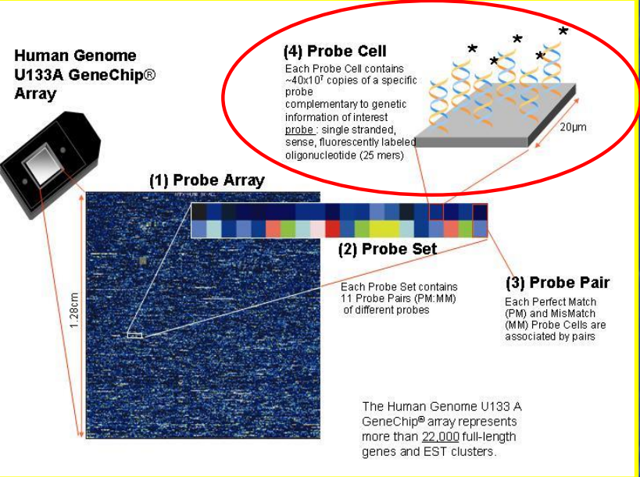
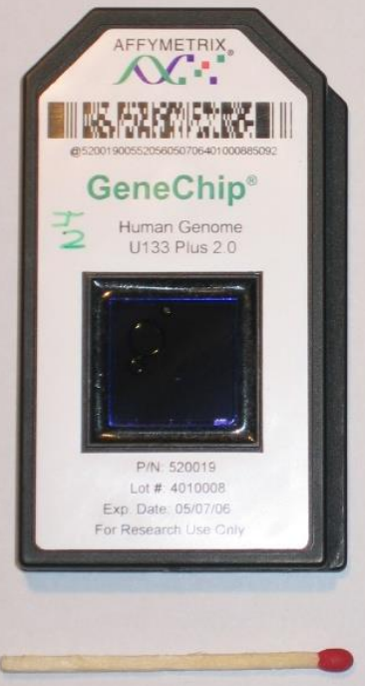
Microarray

Slide 12
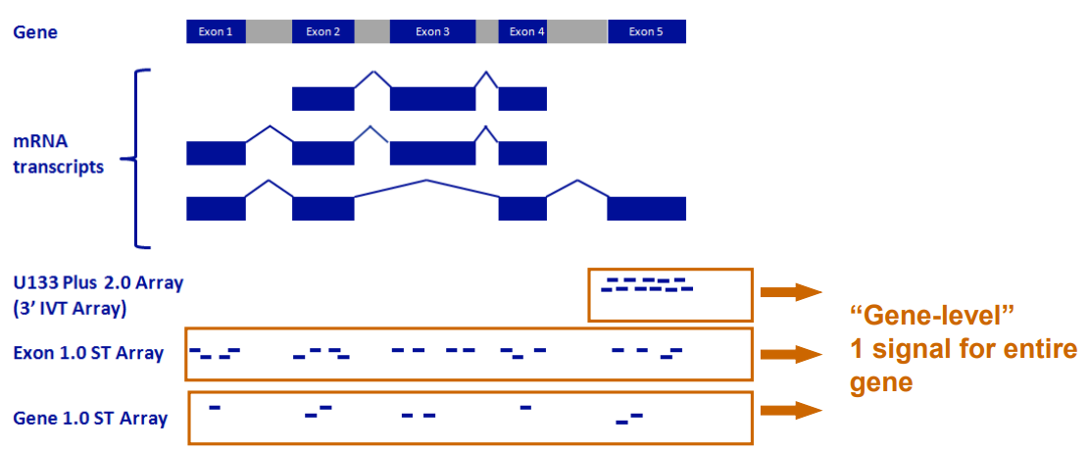
How Microarray work

Slide 13
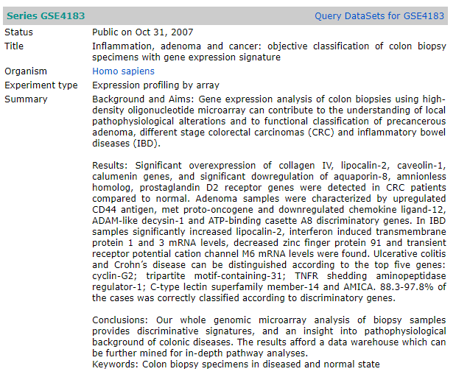
An example of microarray data
https://www.ncbi.nlm.nih.gov/geo/query/acc.cgi?acc=GSE4183

Slide 14
When we analyze a data set, what do we need to know?
Experimental Design
Sample size
Data type and the information conceived by the data
Analysis goal
Design analysis approach
Conduct the analysis
https://www.ncbi.nlm.nih.gov/geo/browse/?view=series&display=500&tax=9606&search=COLON%20CANCER&zsort=samples (ONE LINK TO FIND THE DATA)

Slide 15
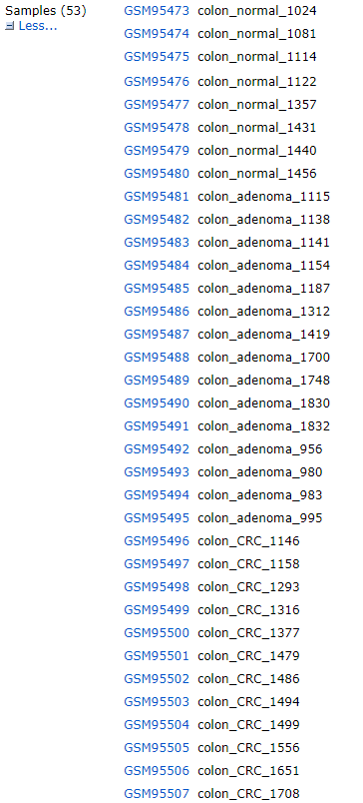
GSE4183 (one data set among the ~171,000 data sets)
53 samples
Colon normal
Colon IBD (inflammatory bowel disease)
Colon adenoma (benign colon tumor)
Colon CRC (colorectal cancer, adenocarcinoma, malignant)
What questions we can ask?

Slide 16
Data analysis and visualization
Continue GSE4183 analysis
Dimension reduction
Sometimes it is okay to do research without fully understand the mathematical consideration, but a potential drawback is you do not know when you made a mistake ☺.

Slide 17
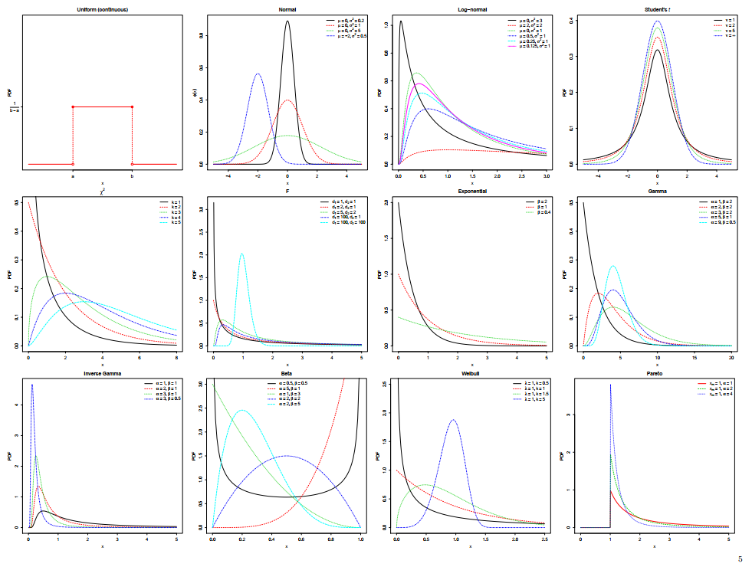
Statistical distributions

Slide 18
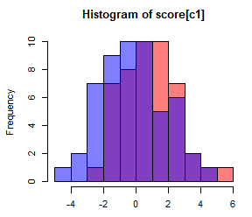
Statistical tests
A statistical test is to assess a statistical significance to reject a statement based on certain observed data
Boys’ height > girls’ height (p = 0.0003)
If Boys’ height = girls’ height is true, the probability to observe the mean difference: mean(Boys’ height) - mean(Girls’ height) = 0.9365616 is about 0.0003, when we made observations from 47 boys and 53 girls.
(reject the happening = approve the probability of this event is very low) based on observed data

Slide 19
Statistical tests
A statistical test is to assess a statistical significance to reject a statement based on certain observed data
Mean of A ? Mean of B
OA={1,2,3,5,6,76,1,23,54,…}, OB={52,100,5000,2103,3675,…}
If mean (A) = mean(B) is true, the probability to observe the mean difference: mean(OA) - mean(OB) = XXXX is about P=YYYY, when we made observations from N1 A and N2 B.
If mean (A) = mean(B) is true, the probability to make the observation: OA and OB is about P=YYYY, when we made observations from N1 A samples and N2 B samples.
(reject the happening = approve the probability of this event is very low) based on observed data

Slide 20
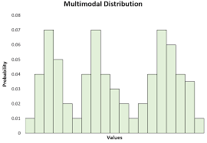
Statistical tests
A statistical test is to assess a statistical significance to reject a statement based on certain observed data
A forms a multi-modal distribution
OA={1,2,3,5,6,76,1,23,54, 52,100,5000,2103,3675,…}
If A forms a unimodal distribution is true, the probability to make the observation: OA is about P=YYYY, when we made observations from N1 A samples.
(reject the happening = approve the probability of this event is very low) based on observed data

Slide 21
A real world question
Top 100 up regulated genes in cancer vs normal out of a total of 50000 genes -> 1/500, 0.2%
A pathway of 2000 genes (cell metabolism)
0/2000 is in the top 100 up regulated genes
2/2000 are in the top 100 up regulated genes 0.1% < 0.2%
4/2000 are in the top 100 up regulated genes 0.2% =0.2%
6/2000 are in the top 100 up regulated genes 0.3% > 0.2%
40/2000 are in the top 100 up regulated genes 2% >> 0.2%
100/2000 are in the top 100 up regulated genes 5% >> 0.2%
>? =? >>?

Slide 22
Hypergeometric test
 | Up regulated genes | Not up regulated genes | Total
Genes in the Pathway | 40 | 1960 | 2000
Genes not in the pathway | 60 | 47940 | 48000
Total | 100 | 49900 | 50000
Enrichment test: If the pathway is enriched by the up regulated genes
Reject: the pathway is independent to the up regulated genes
Observation (T) = the contingency table
If the pathway is independent to the up regulated genes is true, the probability to make the observation: T is about P=0/10000 based on a permutation test, when we made observations from a gene list of 100 genes, a pathway of 2000 genes, and a total of 50000 genes

Slide 23
Permutation tests
Observation
Having a score to show the difference (or some other goals)
Random re-sampling many times
Generate an empirical distribution of the score
Compute the frequency of the randomized score that is larger or lower than the observed score (true score)
Strength (high correctness especially when observed sample size is large)

Slide 24


Hypergeometric distribution
Bernoulli distribution
P(X=1)=p, P(X=0)=1-p
Example: toss a coin
Binomial distribution
A series of same (i.i.d, identical and independent) Bernoulli distribution
Example: toss a coin n times, each time: P(X=1)=p, P(X=0)=1-p
Total number of positive side ~ binomial distribution
Hypergeometric distribution

Slide 25
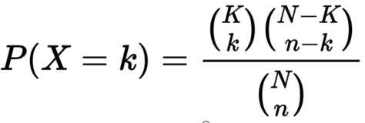
Hypergeometric distribution
Hypergeometric distribution
N genes in total
K are up regulated genes
We have a pathway of n genes
We observed k genes out the n genes in the pathway are up regulated
 | Up regulated genes | Not up regulated genes | Total
Genes in the Pathway | 40 (k) | 1960 | 2000 (n)
Genes not in the pathway | 60 | 47940 | 48000
Total | 100 (K) | 49900 | 50000 (N)
1-phyper((k)10, m(n)=2000, n(N)=50000, k(K)=100)

Slide 26
The hypergeometric test uses the hypergeometric distribution to measure the statistical significance of having drawn a sample consisting of a specific number of k successes (out of n total draws) from a population of size N containing K successes. In a test for over-representation of successes in the sample, the hypergeometric p-value is calculated as the probability of randomly drawing K or more successes from the population in N total draws. In a test for under-representation, the p-value is the probability of randomly drawing K or fewer successes.
The null-hypothesis here is that the probability of seeing k up regulated genes in the pathway of n genes is equal to the probability of seeing an up regulated genes in all the genes, which equals to

Slide 27
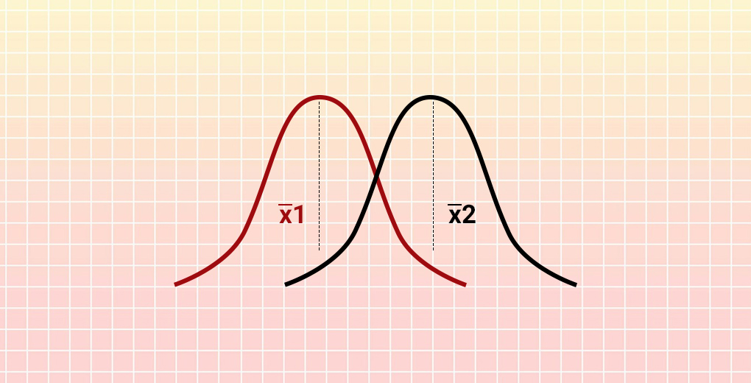
Statistical tests
Permutation test or simulation-based test
Sometimes it is okay to do research without fully understand the mathematical consideration as a high school student, but a potential drawback is you do not know when you made a mistake ☺.

